Slide 1
Polynomial Time
and Dependent Types
Author: Bob Atkey
Presenter: Eric Bond
MPLS Reading Group
March 2024
Notes:
Ok so lets get started..
Today I'll be presenting Polynomial Time and Dependent Types
This was an accepted paper in POPL this year written by Bob Atkey
This paper caught my interest because it involves complexity theory and type theory.
Or , as some call them, Theory A and Theory B
In this paper Bob combines ideas from both camps, which results in a type theory that can be used to write programs that are sound and complete for polynomial time.
Additionally, the type theory also has the ability to reason about the correctness of those polytime programs.
So Lets dive in with an example

Slide 2
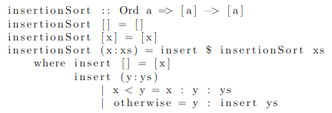
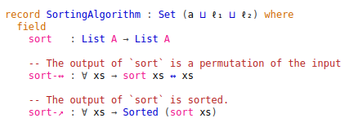
Motivation
Notes:
Say we want to verify the correctness of this program.
This is a routine exercise in interactive theorem proving.
CLICK
If you were using Agda, you'd likely show that insertion sort is an instance of this Type. That is to say, it’s a transformation on Lists where the output is a permutation of the input, and the resulting list is sorted.
But, If I were to ask you to verify that this function sorts a list in polynomial time, you'd probably be lost.
Reasoning about the computational resources used by a function is not as common as reasoning about the correctness of a function.
That said, you may be familiar with research that tries to quantify the computational resource usage of programs.

Slide 3
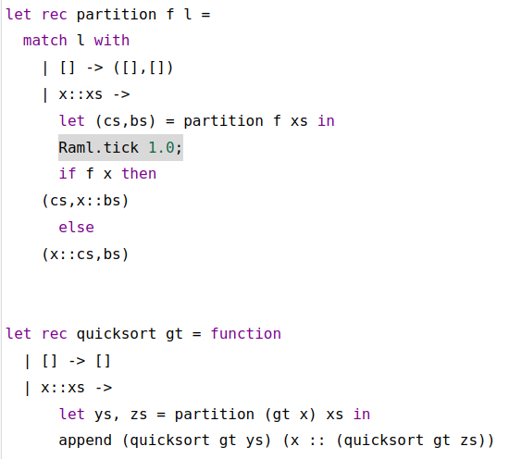
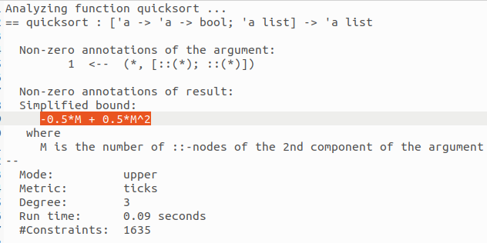
Existing Solution - RaML
https://www.raml.co/interface/
Notes:
[Some existing work]
One approach to this is to consider cost as a computational effect
In this approach, the programmer inserts special expressions, called TICKS, into a program where a Tick expression represents the usage of some computational resource.
One implementation of this strategy is used by Resource Aware ML
According to their website "Resource Aware ML (RaML) is a tool that automatically and statically computes resource-use bounds for OCaml programs."
Here is an example of their tool analyzing the complexity of quick sort.
We see that they insert a TICK in the partition step.
CLICK
Their tool can then infer an upper bound based on some analysis.
The result of this analysis is an upper bound that is quadratic.
While this is a nice automatic solution, we can't directly use it in a prover like Agda.

Slide 4
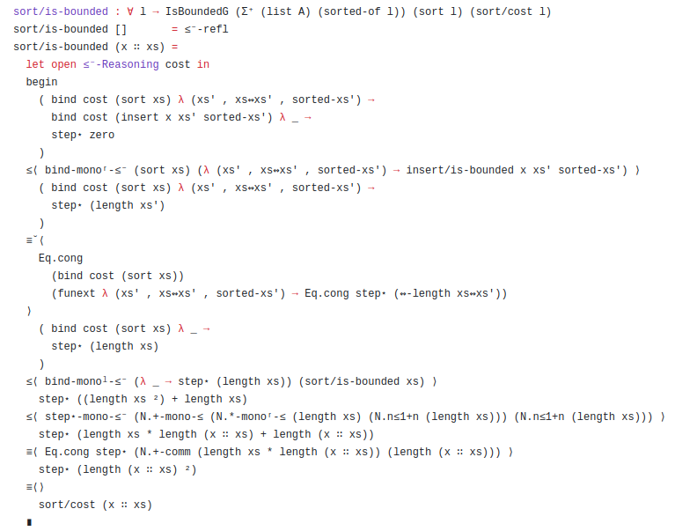
Existing Solution - CALF
😔
Notes:
Fortunately, Harper's group at CMU has a solution by the name of CALF or Cost Aware Logical Framework.
Calf is based on the same principle of cost as a computational effect but it requires manual proof instead of automatically inferring a bound
CLICK
For instance, Here is an example proof that the time complexity of insertion sort is quadratic relative to its input.
It reads, given a list, which is measured by length, the sort function has a bound of n squared
This solution is quite elegant and useful but it requires users to manually prove complexity bounds. CLICK
Consider this:
What if proving that insertion sort has poly time complexity is just a subgoal in our larger mission of proving an entire program has poly time complexity?
CLICK
Suddenly the task becomes extremely overwhelming as you realize you’ll be hacking on agda proofs for decades

Slide 5


Shift in Perspective
Proving complexity bounds in an unrestricted language
verses
Programming in a language which guarantees complexity bounds
Notes:
So neither of these solutions are satisfying
The automatic solutions risks giving your program lyme disease and can’t be used in an interactive prover
The manual solution allows you to prove nice bounds, but the proof obligations become enormous
what if we could make all those complexity bound proof obligations disappear?
Reformulate the problem with a shift in our perspective
Instead of trying to analyze our program written in a language which does not constrict computational resource usage..
What if we wrote our program in a language which guarantees polynomial time bounds?
Do such languages exist?
Surprisingly, yes! And we will see an example

Slide 6
Overview
QTT
LFPL
Applications
Notes:
So here is our roadmap
CLICK
First I'll Introduce LFPL, a type theory which is sound and complete for polynomial time computation
CLICK
Then I'll explain how we can reason about LFPL programs. We will see that the LFPL type theory can nicely embed within quantitative type theory. So I'll explain abit about quantiative type theory and this embedding
CLICK
And finally, I'll talk about some applications of this work
This diagram is a graphical depiction of this paper's contribution.
It is an fun result which boils down to an elegant synthesis of existing ideas.
So let's start with LFPL

Slide 7
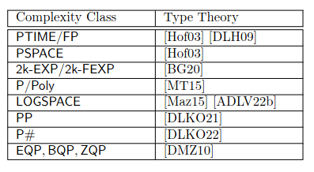
Implicit Complexity Theory
Some ICC Results
Notes:
Bob’s paper relies heavily on results form implicit complexity theory
Implicit complexity theory as a subfield emerged in the early 90s. And from implicit complexity theory, we have many type theories which characterize different complexity classes
This figure is from an implicit complexity theory survey I did with Matthew and Yuxuan
It is obviously incomplete and I made it mostly to show the diversity of complexity classes rather than an enumeration of results for a specific complexity class.
Bob’s paper highlights two different polynomial time languages
One called a cons free language which allows non iterable data types
These data types essentially allow you to pattern match on them but you can’t have a full recursor
A less restrictive language for polynomial time is LFPL which is the one I’ll be highlighting here
And for this presentation, I won’t be explaining in detail how LFPL is sound and complete for polynomial time.
But if there is an interest, I’ll present more on implicit complexity theory in a later reading group

Slide 8
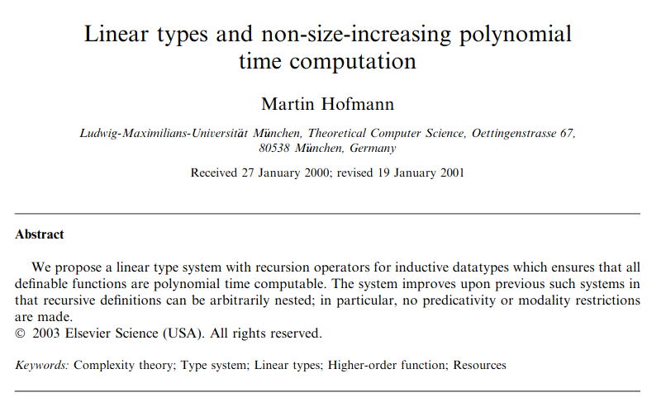
Implicit Complexity Theory
Notes:
LFPL was introduced by Martin Hofmann in the early 2000s
Hofmann was a prolific author in the field of Implicit complexity theory which aims to classify complexity classes by linguistic constraints on how programs are constructed.
Some of the earliest results in implicit complexity are based on the observation that restricting how functions use their inputs affects their resource usage and time complexity.
One of the ways you can restrict a functions usage of its inputs is by imposing bounds on the number of times a variable can be used in a function’s body.
Today we call type theories that impose these constraints linear, or more generally, graded type theories.

Slide 9
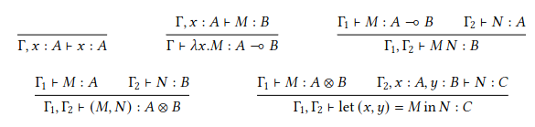


LFPL
Notes:
The core of LFPL is an affine type system, meaning that variables can appear at most once in a term.
CLICK
Here are the introduction and elimination rules for variables, functions and products.
This is the usual presentation of a linear/affine type system where we partition the context in the hypothesis and use the tensor version of product elimination.
This on its own is not very useful language so we can add data types.
CLICK
Here are the introduction rules for zero and successor
Notice that each constructor requires a term of type diamond to construct.
Diamond is type with one inhabitant which is used to enforce a notion of cost when constructing data.
There is no way for a programmer to construct a term of type diamond. If they could, then they could construct an exponentially large natural number.
Instead, diamonds are released when iterating over data.
CLICK
Here is the iterator for natural numbers.
Observe that terms M of type A in the hypothesis require diamonds construct.
The cost for constructing these terms is payed for by destructing the natural number that is being iterated over.

Slide 10
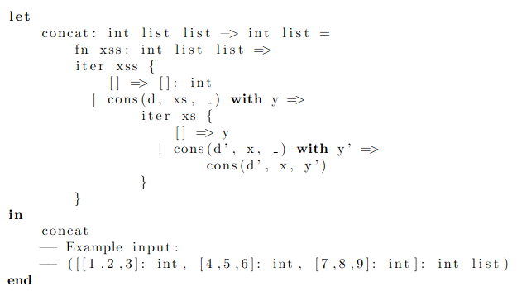
LFPL
https://github.com/ishantheperson/LFPL/blob/main/test/concat.lfpl
Notes:
We can repeat this strategy with other data types like lists and trees where constructors require diamonds and destructors pay out diamonds
Here is an example LFPL program for list concatenation
Diamonds are paid out by destructing lists which are then used in the construction of new lists
The size of the input determines the number of diamonds a program is allowed to use
This example is from an implementation of LFPL we found on github when doing our implicit complexity survey

Slide 11
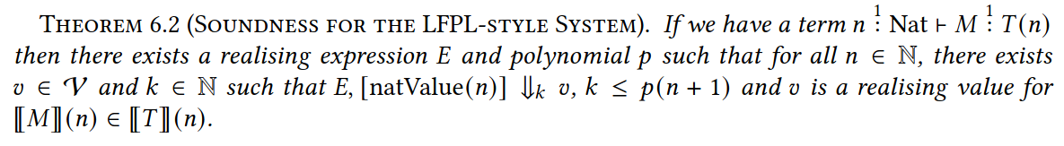
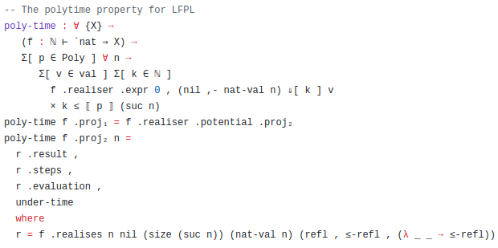
QTT + LFPL Soundness Proof Statement
Notes:
Again I won’t go into detail on the soundness and completeness proofs for LFPL but here is the soundness statement as it appears in Bob’s paper and his agda development
The proof is for programs which take in natural numbers and return a term of a type which may depend on that natural number
Bob adapted the LFPL soundness proof of Hofmann and Dal Lago to his type theory.
The main idea is that they translate terms from their language to an untyped call by value lambda calculus with a costed operational semantics
The statement here says than there is an expression E which represents the program M which evaluates to v in k steps where k is less than a polynomial on the size of the input.
Implicit complexity theory has many more nuanced soundness and completeness proofs than this, especially when you get into logspace
I may end up presenting an implicit complexity theory paper on logspace later this year

Slide 12
Overview
QTT
LFPL
Notes:
So we have a language that is sound and complete for polynomial time, but how do we reason about the correctness of LFPL programs?
CLICK
For that, I will introduce a modified version quantitative type theory which, extends LFPL with dependent typing

Slide 13

Quantitative Type Theory
σ = 0 “normal” DTT
σ = 1 for LFPL typing rules
Qtt Typing Judgement
Q: Should the usage of variables in types cost anything?
A: NO
Notes:
Quantitative type theory is essentially the result of combining the variable usage restriction of linear type theory with dependent types.
Anyone who has used the multiplicities in Idris 2 where types are annotated with 0 1 or omega will have some intuition on how this works
CLICK
This is the general form of a typing judgement in quantitative type theory
Every type ascription in the context is annotated with a natural number. (so rho 1 through n here are natural numbers)
In general they can be elements from a semiring but we’ll stick with natural numbers for now
The meaning of x1 rho1 S1 is roughly “variable x1 of type S1 can be used rho1 many times in term M”
But this is also a dependent type theory! So some of these variables could exist in the type T of M!
CLICK
Here's an important question then, should the usage of variables in types “cost” anything? Or should they be free?
Consider the implications if we answer in the affirmative, that is, variables usage should have a cost in types
CLICK
Think about using terms in specification. Most likely you’ll have some term like a list that you’ll want to write a complicated predicate over.
It doesn’t really make sense to impose usage constraints on how many times you use a term in the specification.
CLICK
So we are going to answer No, the usage of variables in types should cost nothing.
CLICK
And that is where sigma in the typing judgment comes into play.
We want to make a distinction between when a term is used for computation vs when a term is used in a Type or specification
When sigma is 0, this will roughly correspond to the fragment of the language for regular dependent type theory
When sigma is 1, then the LFPL typing restrictions are in play
CLICK
So if we look now at the typing for the insertion sort correctness specification
the typing for insertionSortCorect has 0 for sigma on the typing ascription, which allows for the duplication of xs in the specification type
While the type ascription xs of List A has 1 for sigma, indicating that this list was constructed in the LFPL fragment of the language. Where xs was constructed in polynomial time using diamonds

Slide 14

Quantitative Type Theory
Qtt Typing Judgement
“LFPL” → “DTT”
Notes:
An important admissible rule of this type system should then be the ability to take an LFPL term and use it in the specification setting.
That is represented by the bottom inference rule
So the type system is designed in a way to ensure this rule holds

Slide 15
Quantitative TT + LFPL
Pi and Sigma types
Identity types
Universe types
Diamonds
Booleans
Natural numbers
Lists
Iterable lists
Constructed with diamonds
⭐Realizability types⭐
Notes:
So now I’ll go over a few of the typing rules in this calculus.
I’m not going to cover everything and bore you all will a ton of inference rules.
So I’ll talk briefly about
The Diamonds,Natural numbers, sigma, Iterable lists And realizability types which let us make some cool statements about complexity theory concepts

Slide 16
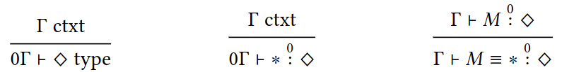
Diamonds (again)
Type Formation
Introduction
Eta rule
Notes:
Here are the formation, introduction, and eta rules for the Diamond type
Notice that the introduction rule for Diamond is only allowed in the specification fragment of the language.
That is to say, the user of this type theory is not allowed to freely construct diamonds in the LFPL fragment because that would interfere with the time complexity guarantees.
However It is possible to construct them for the purpose of using them in specifications.
Earlier I said that the Diamond type only has one inhabitant, the eta rule permits this fact in the specification setting

Slide 17
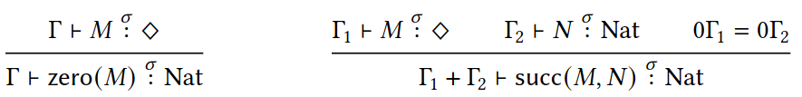
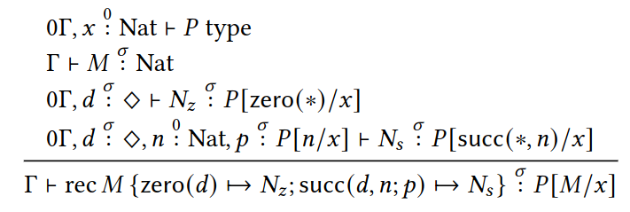
Natural Numbers
Zero constructor
Succ constructor
Recursor
Notes:
On to natural numbers
Here are the constructos
They both require diamonds to construct
But notice that the rules are parametric in the value of sigma
So in the specification fragment, we know that we can freely construct diamonds and therefore we can also freely construct natural numbers
However, in the LFPL fragment, the diamonds in the constructors will have to be paid by deconstructing some other type
The 0gamma1 = 0gamma2 is an artifact of accounting for usage constraints in contexts
You see these kind of obligations in vanilla quantitative type theory so I’m not going to cover them here
CLICK
Here is the dependently typed recursor for natural numbers
It looks complicated but it is simply a mild extension of the non dependent natural number recursor I showed earlier
We see that the type family P can depend on a free natural number x
And that the cases in the recursor still pay out diamond when we deconstruct the natural number

Slide 18

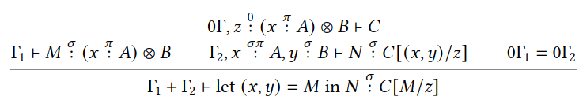
Sigma
Elimination when σ = 0
Elimination when σ = 0 or σ = 1
Notes:
The formation introduction and elimination rules are somewhat similar to vanilla quantitative type theory
One noticeable difference however is that we have two forms elimination
the usual cartesian one on top, and the tensor one on the bottom
Remember that when sigma is 0 we are in the specification fragment of the language without any LFPL typing constraints
This means we can allow the first and second projections forms of elimination when we are reasoning about LFPL programs
but not when constructing LFPL programs
recall that in LFPL, we only had the tensor form of elimination rule.
In Fact, the bottom rule is just a dependent form of tensor elimination from LFPL

Slide 19
Constructing Data Types
Notes:
Instead of simply adding more datatypes to the core language, we can use existing language features to define types.
CLICK
Namely we can use natural numbers, sigma types, and universe types to construct an iterable list type
The list type is defined to be a Sigma type that takes a natural number in the first component.
An important detail is that this natural number is constructed with diamonds in the LFPL fragment
The second component then recurses on the natural number forming a nested product of types
CLICK
We can then define the constructors for our list type using functions
In the base case, List A is just the Unit type
But in the inductive case, List A is a nested product of A types
An important thing to observe, is that the diamonds passed into the list constructors are used to construct natural number in the first component of the sigma type

Slide 20
Overview
QTT
LFPL
Applications
Notes:
Time for a quick review
CLICK
I first introduced LFPL as a linear affine type theory with this notion of paying Diamonds to construct data and earning diamond via destructing data
as solution to guarantee that any program written in LFPL is guaranteed to execute in polynomial time relative to its input
CLICK
I then introduced a modified version of Quantitative type theory which allows us to reason about LFPL programs using dependent type theory while maintaining the complexity guarantees of the LFPL programs
CLICK
From what I’ve covered so far, we can solve our original problem. That is we can write out our sorting algorithm in LFPL, which by construction will guarantee the polynomial time soundness.
And we can then verify the correctness of the algorithm using usual methods in dependent type theory.
I’d love to show you an example of this however Bob’s paper does not fully flesh this out.
(as a minor note, this is a criticism commonly shared amongst his POPL reviewers)
To be fair, he does describe how to go about proving the correctness of insertion sort in the paper but does not demonstrate it with an example program
However,
There are some other applications of this work which I find to be much more interesting than our original example.
Namely, with the addition of Realizability types we can talk about complexity classes and polynomial time reductions

Slide 21
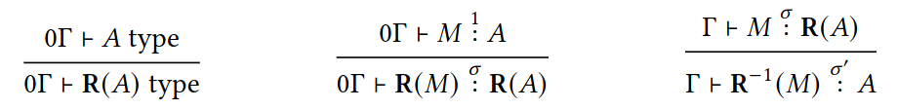


Realizability Types
Type Formation
Introduction
Elimination
When σ = 0 or σ = 1
When σ = 0
Notes:
Currently this type system can construct polynomial time functions and reason about their correctness.
What we’d like to do now, is enable the specification language to be able to make statements like “a term of type A is constructible/realizable in polynomial time”
And for that we are going to introduce realizability types
CLICK
The type formation rule simply allows for any type to potentially be realizable
To actually introduce a realisability type , you must have a term which was constructed in the LFPL fragment of that type
The elimination form is essentially used to unpack the type.
For example, iif you had a type R(nat arrow nat) as an input type and you wanted to apply the underlying function to a number, you would unpack it with the elimination rule
CLICK
Additionally this type has the following equations.
This gives the specification language a way to talk about time complexity of types.
As we will see, we can now express some pretty interesting definitions

Slide 22
Complexity Theory
“Proofs of PTIME(𝐴, 𝑃), are carried out in the 𝜎 = 0 fragment, where we have the full power of Type Theory to aid us.”
“This definition is intrinsic, in the sense that, whichever of the polytime systems is chosen, proving that a decision problem is solvable in polytime is a matter of programming, without having to reason directly about machine models and step counting.”
“We have defined problems to have arbitrary types 𝐴 as domains, rather than bitstrings, and so the notion of size attached to an input is intrinsic to the type 𝐴 chosen.”
Notes:
For our first example
We can define the type of polynomial time decision procedures
CLICK
A decision procedure in this language is a pair (A which is a type, and P a predicate on A)
The type of polynomial time decision procedures is then a sigma type where the first component is a polynomial time computable function f from A to bool where f (a) is true whenever P(a) is true
CLICK
We could also describe the type of polynomial time reductions as a sigma type where the first component
Is a poly time function between base types
The second component ensures the map preserves problem instances
CLICK
Bob makes a couple of important observations here which I’m going to quote verbatim from the paper
“Proofs of PTIME(𝐴, 𝑃), are carried out in the 𝜎 = 0 fragment, where we have the full power of Type Theory to aid us.”
“This definition is intrinsic, in the sense that
proving that a decision problem is solvable in polytime is a matter of programming,
without having to reason directly about machine models and step counting.”
“We have defined problems to have arbitrary types 𝐴 as domains,
rather than bitstrings, and so the notion of size attached to an input is intrinsic to the type 𝐴 chosen.”

Slide 23
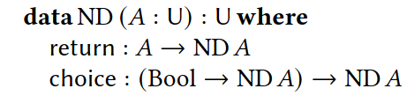
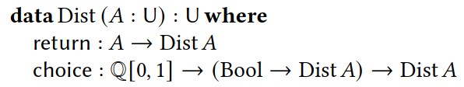
Other Complexity Classes
Notes:
Using the realizability of polynomial time functions as a base, Bob then goes on to give possible characterizations of complexity classes NP and BPP.
The main idea is to enhance function types with computational effects
CLICK
The first one is non determinism which allows for branching in the choice constructor
CLICK
NP problems can then be classified as a nondeterministic polynomial time function
which, given a list of nondeterministic choices, can be used to determine if an input is in predicate P
CLICK
BPP is a bit more complicated because we have probabilistic choice but it follows the same principles
CLICK
Given a polynomial time function with the distribution effect, we can define the type of BPP problems
It should be noted that many type theories developed under implicit complexity theory do not have the ability to reason about the terms in the way this calculus allows for.
Many implicit complexity theory results simply define the equivalent LFPL fragment and do the soundness and completeness proofs.
One last thing I’ll point out before concluding
In our survey on implicit complexity theory we saw a repeating theme where
common algorithms for a particular problem in a complexity class were ruled out because of the inflexibility of the type theory.
In theory you can come up with an alternate algorithm that works in the type theory but it is a pain point to be aware of
For instance, consider trying to write graph algorithm in this setting

Slide 24
Concluding Remarks
Capabilities
Write polytime programs
Prove their correctness
Define complexity theory concepts
Future Work
Explicit resource bounds?
Internalize realizability proof (prove Cook Levin)?
QTT
LFPL
Notes:
we started with a simple motivating example
How to prove the correctness and runtime properties of a simple program
We could do this using CALF but Proving explicit runtime bounds for programs is seemingly quite hard
Another option is to use a language which guarantees poly time soundness and for that we use LFPL
LFPL , as a variant of linear type theory, embeds quite nicely in a modified quantitative type theory
Allowing a user to write poly time programs and prove their correctness
With the addition of realizability types, this theory allows for simple complexity theoretic definitions to be expressed
A capability which turns polynomial time reduction between pollytime solvable problems into a matter of programming and proving within the same system
Notably, because LFPL is an implicit characterization of polynomial time programs, we can’t sate explicit polynomial time bounds and prove them as we could in CALF
Additionally, complexity theoretic proofs like cook levin are not possible with the simple realizability type.
This is because cook levin requires accessing the “source code” of the polynomial time function which would require internalizing some aspects of the realizability proof which Bob has highlighted as potential future work
That’s all I’ve got for today

